Slide 1
SFP Demo Configuration Handbook WxCC 2.0
CCBU Solution Assurance
Document version 1.0
30-10-2020

Slide 2
What is this about ?
What is this Not about ?
Anyone with a WxCC 2.0 tenant access should be able to configure it to demonstrate the capabilities of this platform in their own demo/Gold tenants.
This handbook will be shared internally first (TME, TSA, Sales, Mktg) and eventually to partners in EFT
This is a ‘living document’, more capabilities will be added as they become available
This helps provide a consistent demo experience
Training/Deep dive session
Step by Step demo guide/story with speaker notes (Will be a separate effort)

Slide 3
Overall Pre-Requisites / Assumptions
1 | Steps in this guide are based on and for configuring a tenant in production environment
2 | Users of this guide already have administrator access to a production tenant
3 | Voice connectivity is available on the production tenant
4 | DN to EP mapping is done with a working DN
5 | Users of this guide already have Email ID for email contact routing
6 | Users of this guide already have a SMS Number procured from MessageBird, that can be integrated with the tenant.
7 | Users of this guide already have a Facebook page which can be integrated with the tenant
8 | Users of this guide already have a Google CCAI account that can be configured in the tenant
9 | Tenant has Feature Flags enabled for desktop layout, Chat/Email, Virtual Assistant, Social, FlowControl
10 | All config entities are created with prefix MediAssist For example: Site: MediAssist_Site, Team: MediAssist_Team, EP: MediAssist_Voice_EP

Slide 4
Config Handbook - Who & Where ?
Module-1 | User Onboarding | Ankit
Module-2 | Chat | Abhishek
Module-3 | Email | Naveen
Module-4 | Social | Chandra
Module-5 | Voice | Avinash
Module-6 | WxM Post Call Survey | Raghu
Module-7 | External DB Dips | Chandramouli
Module-8 | Agent Desktop(KAD) | Sameer
 | Support/Facilitator | Gagarin
 | Reviewers/Mentors | Karthik/Mudit
Environment | ProdUS1 (WxCC US DC)
Org | Webex CC Demo 101
Org ID | 12700722-cd25-46b9-971e-ed0ce9f140c6
Access | <cec>@email.carehybrid.com
Control Hub | https://admin.webex.com
Portal | https://portal.wxcc-us1.cisco.com/portal/home.html
Agent Desktop | https://desktop.wxcc-us1.cisco.com
Main IVR | 516-517-9009
Sample API for Ext. DB Dip | https://5f9a64f59d94640016f709bf.mockapi.io/api/customers/account

Slide 5
Objective: This lab is designed to ensure we onboard various user personas in to WxCC.
As part of this guide, we will cover following steps:
Important: Let's use a naming convention in order to help us maintain this tenant. Please use the format from below. Most important, always lead with your username.
Voice Configuration:
Create EP = <username>_voice_EP ie: (ntheolog_voice_entrypoint)
Map DiD to your EntryPoint.
Create your Team = <username>_team
Create Q = <username>_voice_Q
Create EP Routing Strategies = <username>_RS_voice_EP
Create Q Routing Strategies = <username>_RS_voice_Q
Associate Teams to respective Q

Slide 6
Webex Calling
Add your DN Configuration

Slide 7
Objective: You will be able to associate a DN to your Agent(s) then use that DN to log into Desktop and accepts calls.
Note: Steps provided in the document do not include setting up an endpoint device on Control Hub.
We are using a soft client (webex calling app)
Control Hub
Add your Webex Calling DN
WxCC Portal Administration page:
Login into Desktop with Webex Calling DN

Slide 8
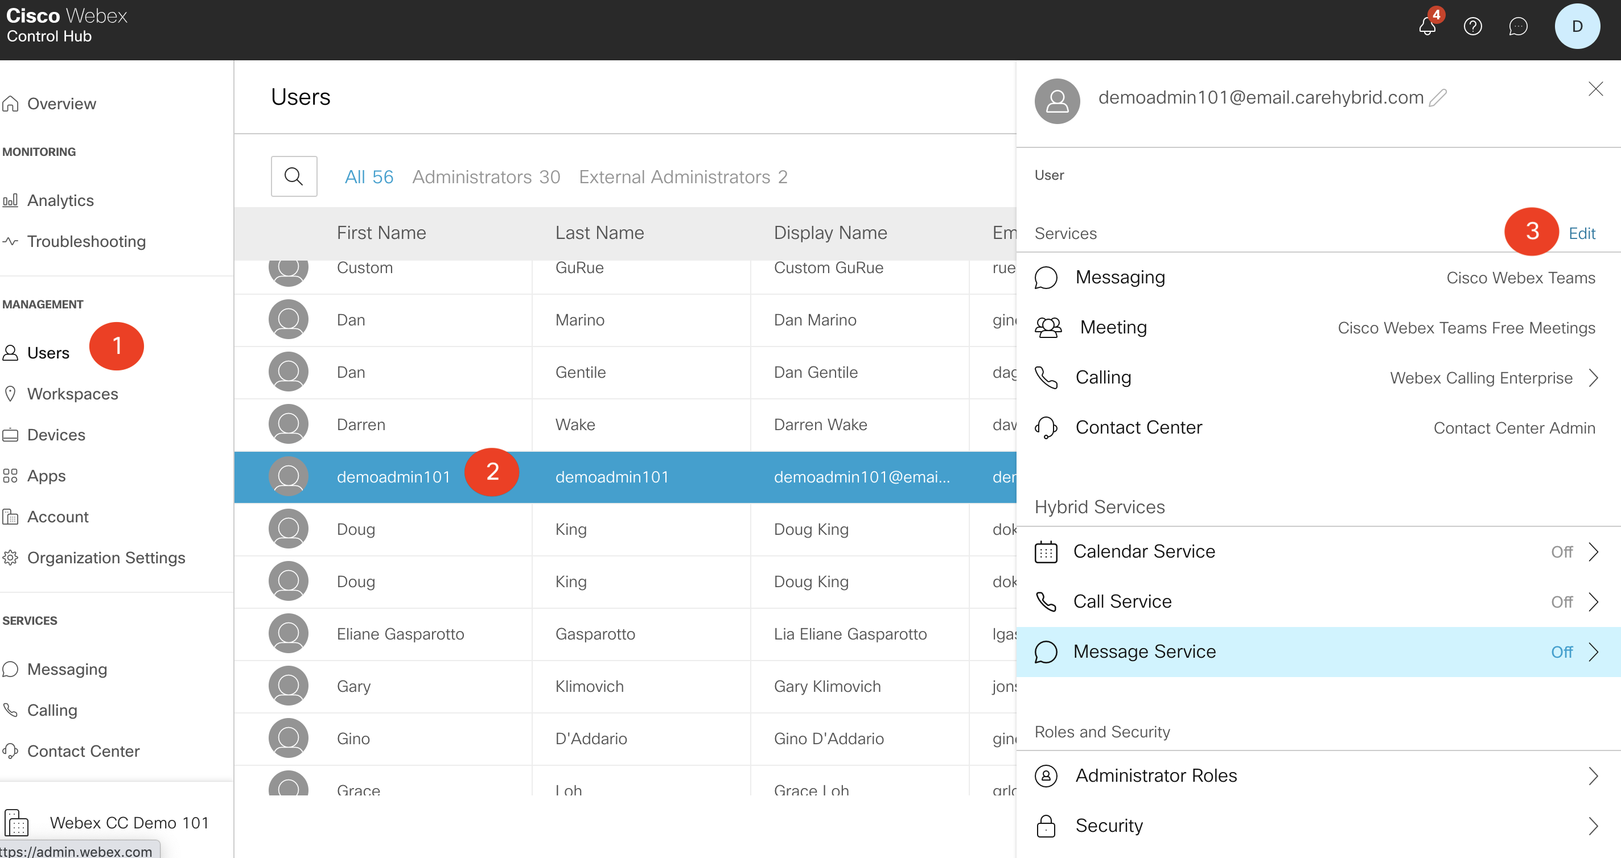
Steps:
Login into the Webex Control Hub and go to Users under the Management Section
Click on your User
Click Edit

Slide 9
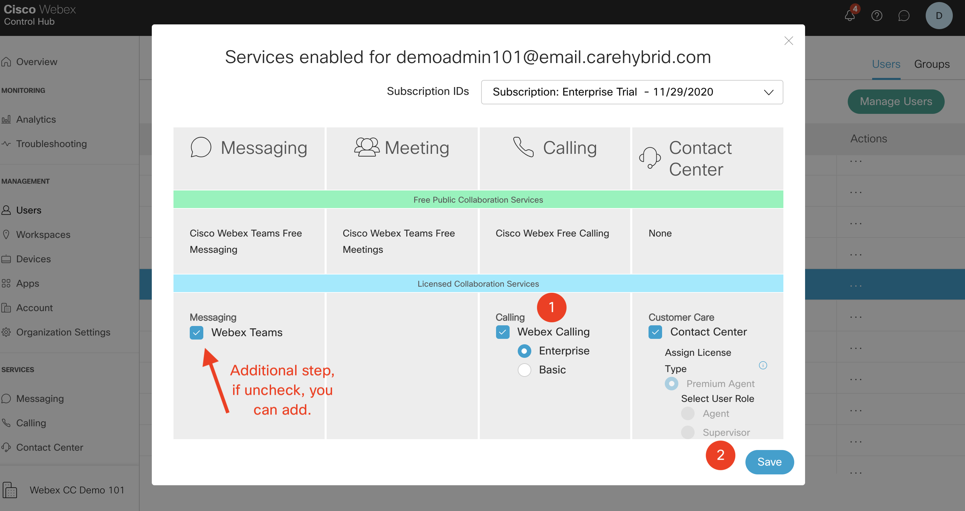
Steps:
Click on Webex Calling , choose Enterprise
Click Save

Slide 10
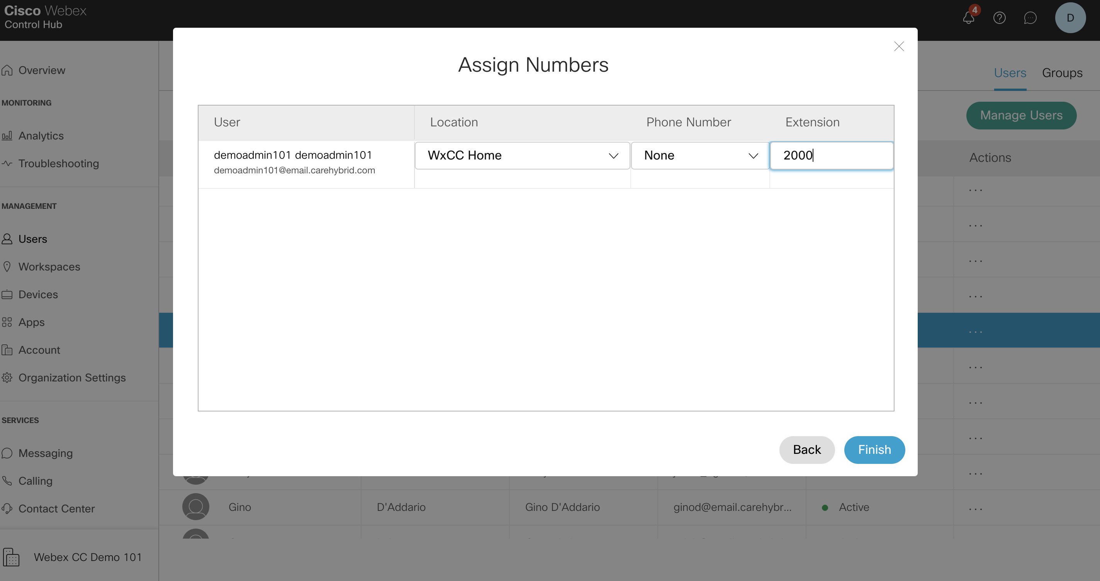
Steps: ( below spreadsheet with DN info::)
https://cisco.sharepoint.com/:x:/s/CCBUSolutionAssurance/EVukdrdrIehOu04hgqkfMawBxhWCZMn0s2zIQTCH4s24pQ?e=4%3Ak0kJ6j&at=9
Add your DN in the Extension field. Keep everything else default….
Click Finish
1
2

Slide 11
Steps: The endpoint used for testing was the Webex Calling App.
Links below, should prompt you to download the app. (copy and paste into your browser)
Windows version: https://cisco.sharepoint.com/sites/CloudCalling/Shared%20Documents/Forms/AllItems.aspx?id=%2Fsites%2FCloudCalling%2FShared%20Documents%2FDevices%20DLT%2FWebex%20Calling%20Desktop%20Clients%2F22%2E9%2E8%2FWebex%5FCalling%2Ebc%2Duc%2Ewin%2D22%2E9%2E8%2E261%2Emsi&parent=%2Fsites%2FCloudCalling%2FShared%20Documents%2FDevices%20DLT%2FWebex%20Calling%20Desktop%20Clients%2F22%2E9%2E8
Mac OS version: https://cisco.sharepoint.com/sites/CloudCalling/Shared%20Documents/Forms/AllItems.aspx?id=%2Fsites%2FCloudCalling%2FShared%20Documents%2FDevices%20DLT%2FWebex%20Calling%20Desktop%20Clients%2F22%2E9%2E8%2FWebex%5FCalling%2Ebc%2Duc%2Eosx%2D22%2E9%2E8%2E207%2Edmg&parent=%2Fsites%2FCloudCalling%2FShared%20Documents%2FDevices%20DLT%2FWebex%20Calling%20Desktop%20Clients%2F22%2E9%2E8

Slide 12
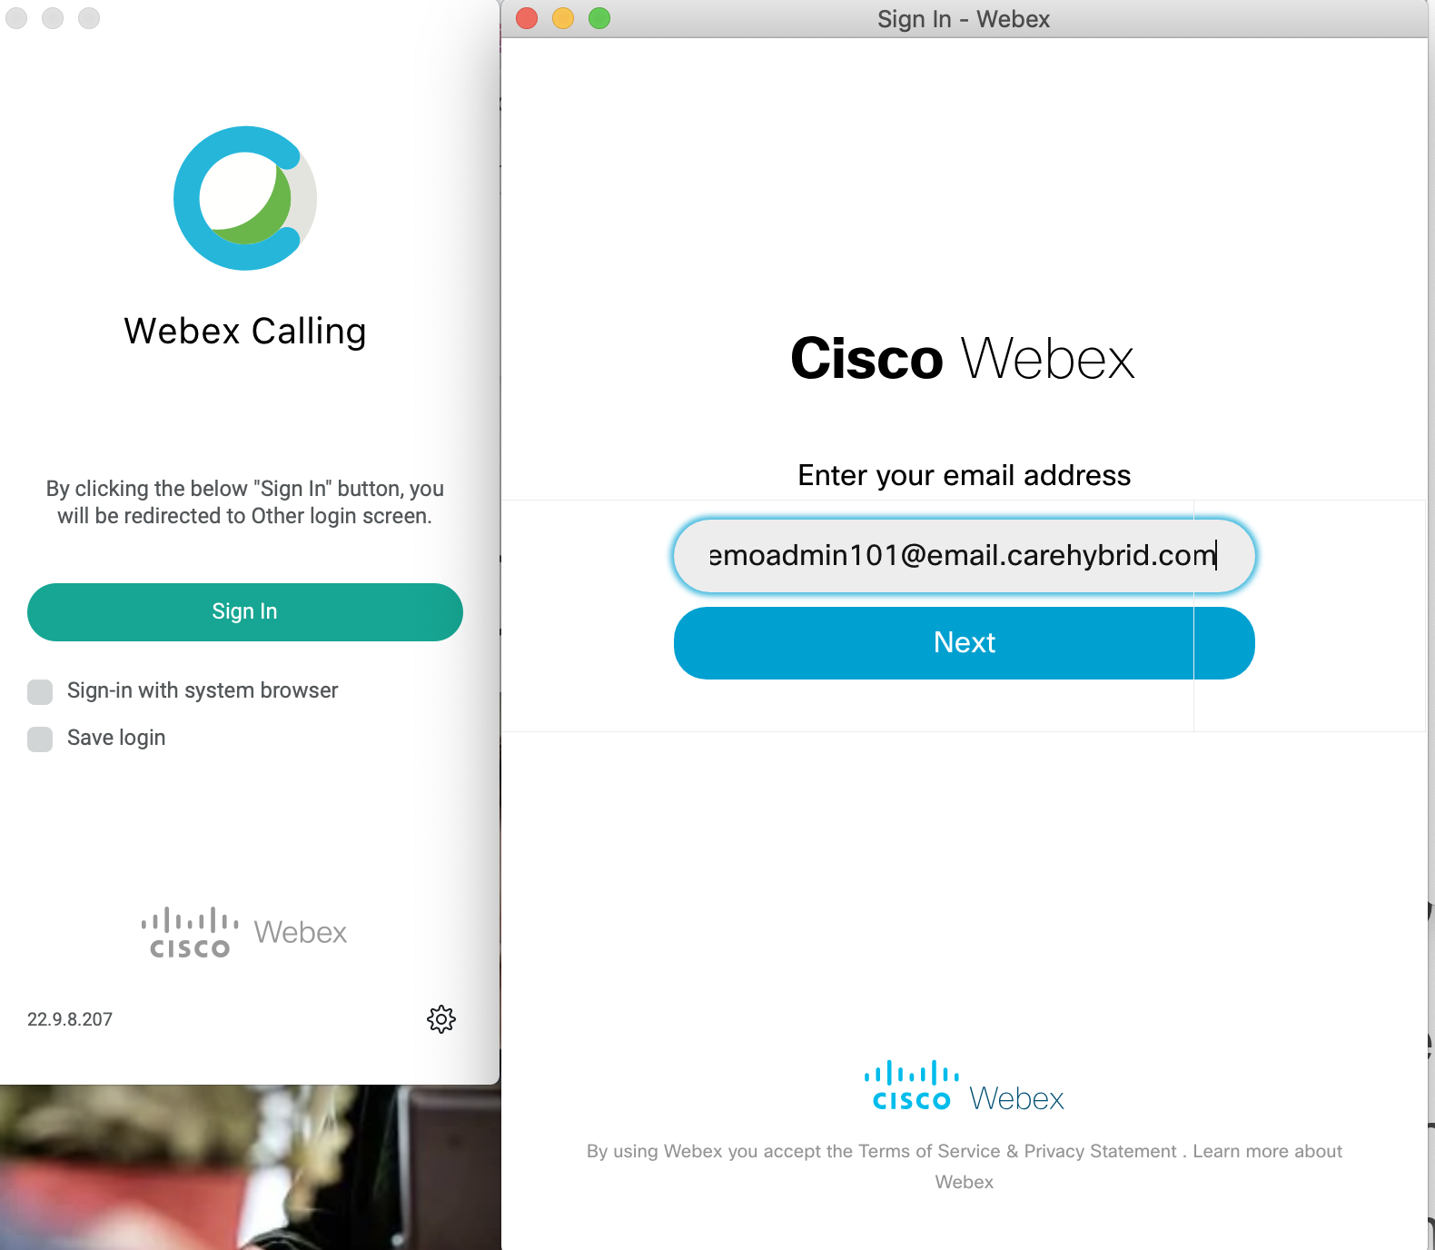
Steps: The endpoint used for testing was the Webex Calling App
Click sign-in
Use your Agent credentials ie (<userame>@email.carehybrid.com)
2
1

Slide 13
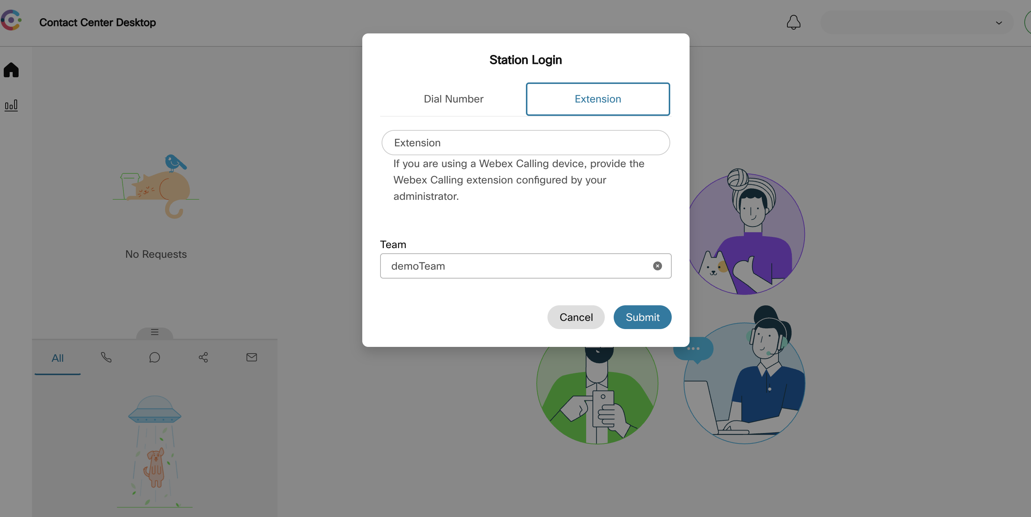
Steps: Login into Desktop
Add your DN in the Extension field. Keep everything else default….
Click Finish
Don’t forget to assign your appropriate Team
1
2
3

Slide 14
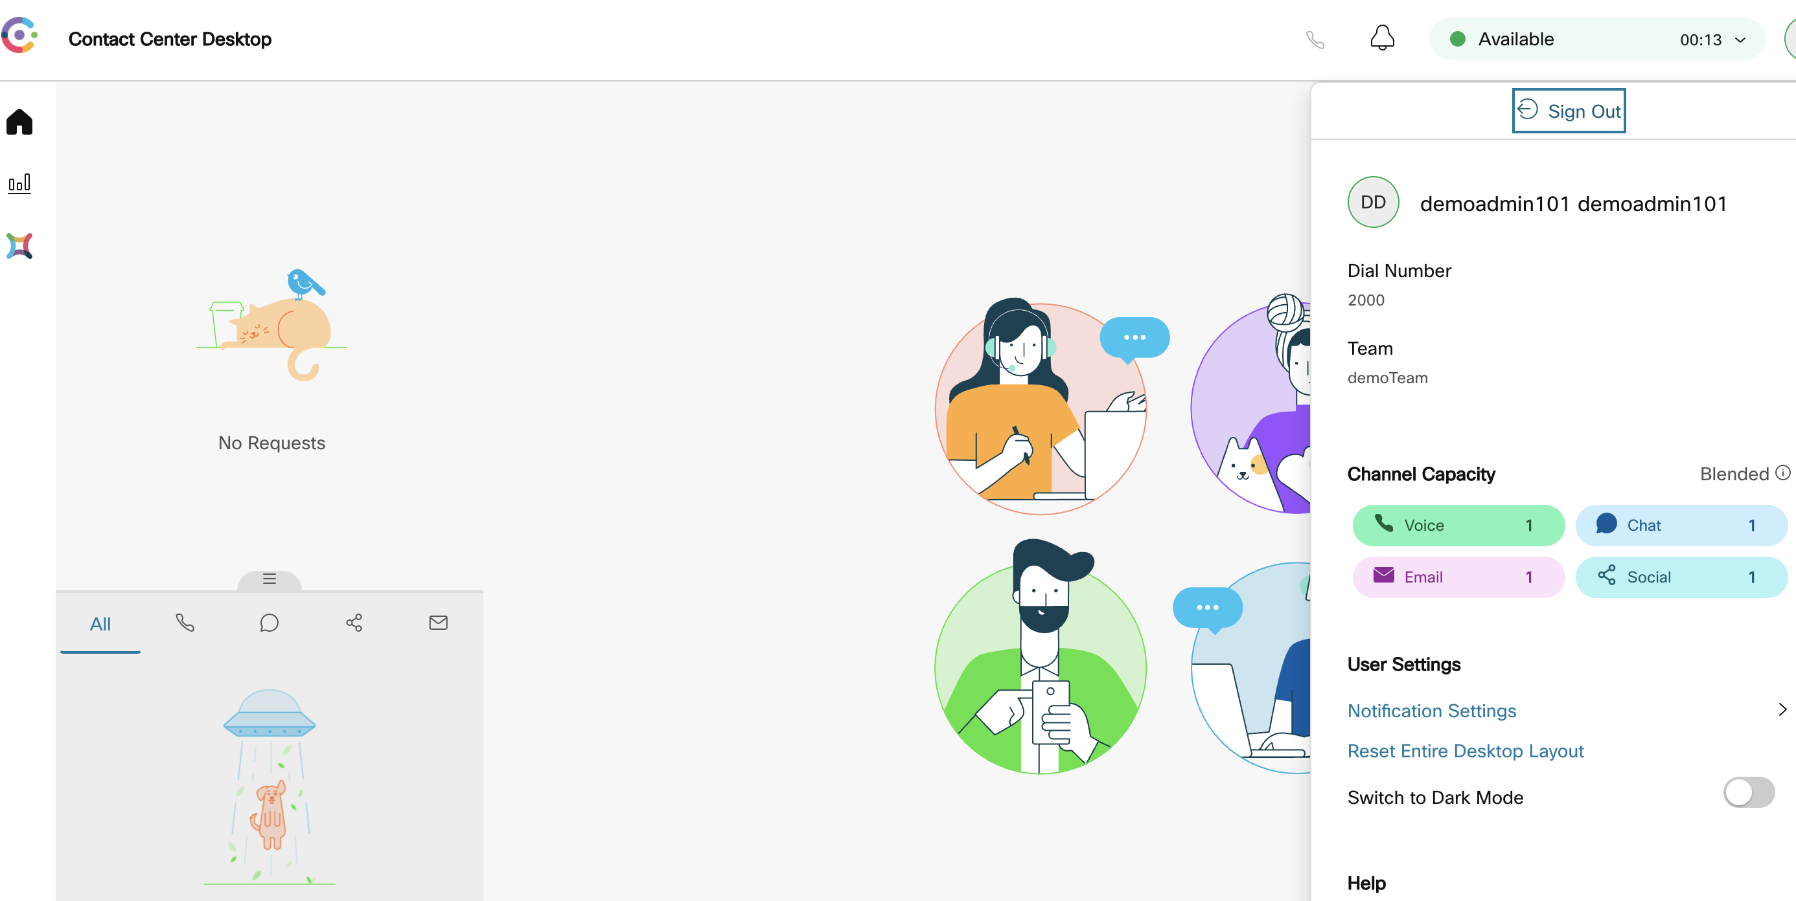
Steps:
You can verify your logged in with you DN
1

Slide 15
Summary:
We added Webex Enterprise licensing to our Agent(s) and associated a 4 digit DN to them.
Verify Below points:
Login to agent desktop with new DN
Initiate a call to the IVR
Pick up the call

